Slide 1

LFG Made Easy

Slide 2

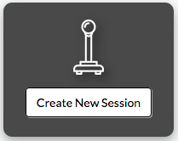
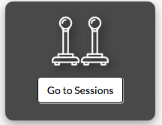
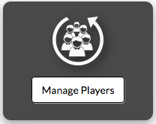
Create new session
Text 1
Revisit created sessions
Text 1
Manage players
Text 1

Slide 3

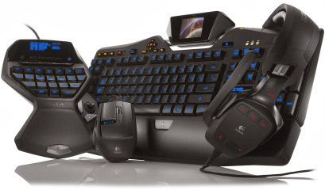
Sequelize
We used sequelize to do some things on the webpage
MySQL
we store some stuff in MySQL
Express
Item 1
Body-parser
Item 1

Slide 4

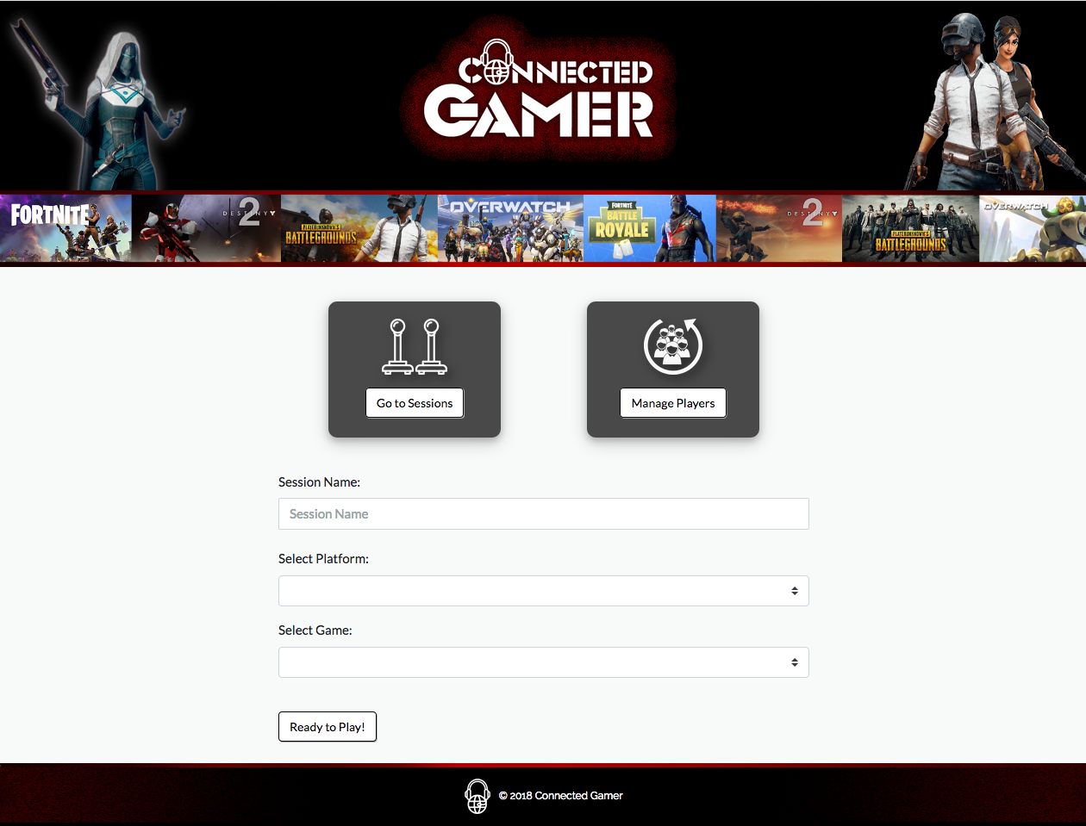
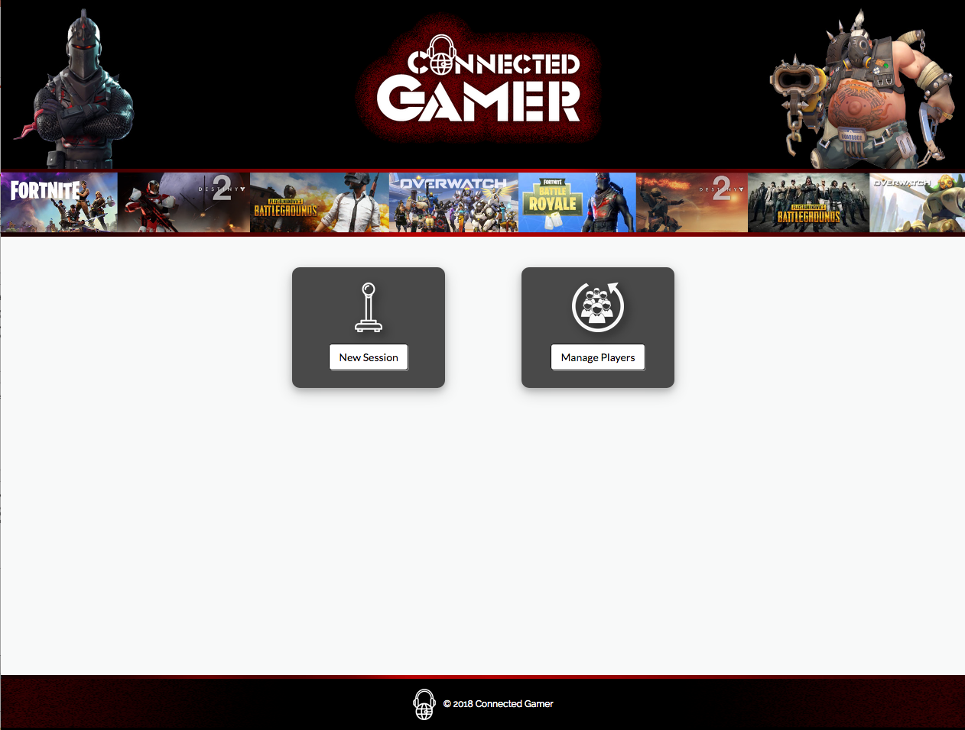
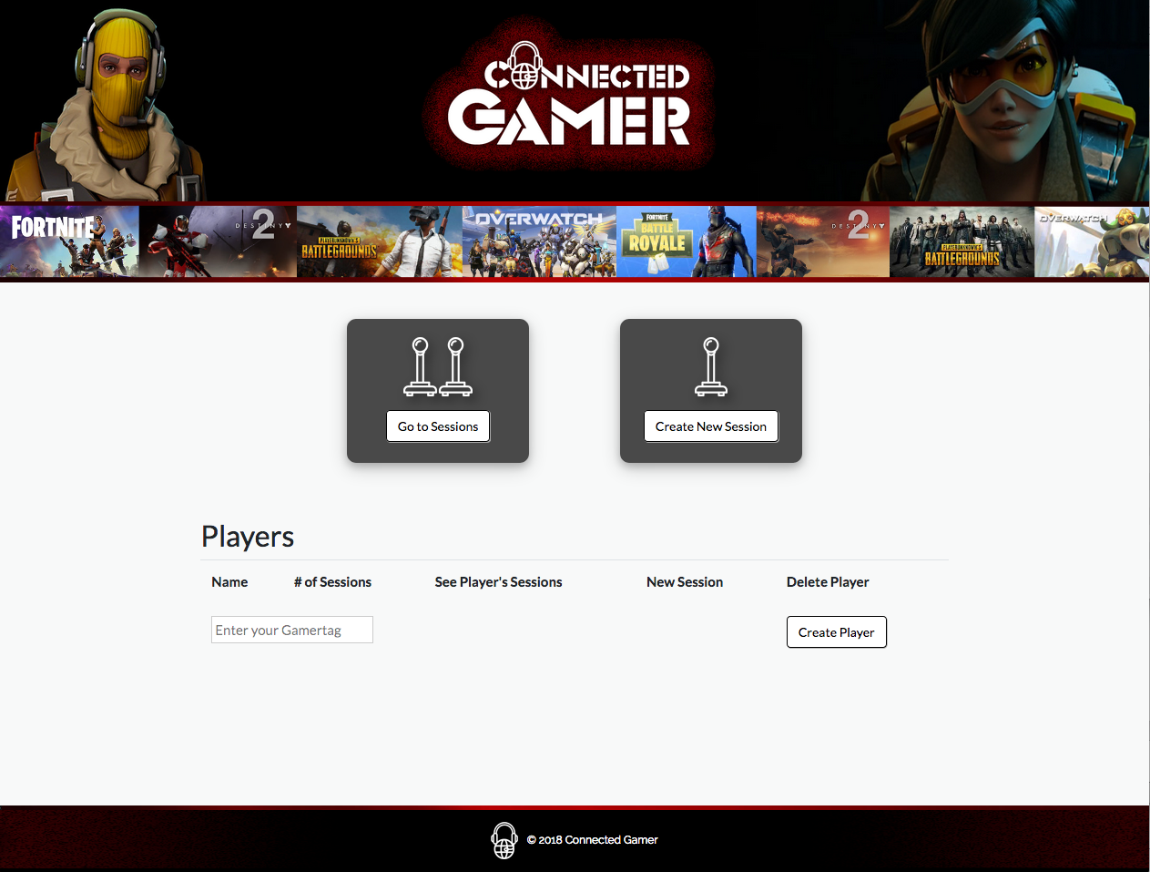

Slide 5

Login
Store

